Slide 1

LEGAL EASE
A centralized platform helping you find the right legal experts, view verified profiles, and book appointments in seconds.

Slide 2

List of Members and Supervisor
Supervisor. | Lê Mộng Thúy
Batch. | T3.2508.E1
Group. | 3
Serial No. | Student Name | Enrollment Number
1 | NGUYỄN ĐỨC LONG | Student1685473
2 | HOÀNG NGỌC LÊ | Student1865556
3 | CHÂU NHẬT MINH | Student1689260
4 | NGUYỄN HOÀNG SƠN | Student1685526

Slide 3

Content Overview
Project Introduction
Objectives
Applied Technologies
Website Features
Team Task Allocation
Flow Diagram

Slide 4


Project Introduction
Is an online legal service connection platform that helps optimize lawyer searching and appointment management. The project addresses the issues of time waste and lack of transparency in the legal field by providing a public rating system and real-time booking.
Public rating system
Real-time booking
Smart AI-powered consultancy support

Slide 5





Application Objectives
Practical Experience
Overcoming Barriers
Apply academic knowledge to professional real-world scenarios.
Eliminate time wasted on searching and manual booking processes.
Transparency
Automation
Verified profiles, authentic reviews, and clear service pricing.
Systematize availability and provide automated notifications for clients & lawyers.

Slide 6




Technologies Used
Backend
Database
Frontend
Laravel Headless API
MySQL Engine
ReactJS Library
CSS Modules
Model–Controller Pattern
XAMPP Environment
Vite Build Tool
React Icons
Eloquent ORM
Relational DB Design
TanStack Query
Toast Notifs
RESTful API with Sanctum
Zustand (State)
SweetAlert2
Role-Based Middleware
Axios Client

Slide 7



Guest User Role
Public Access & Search
Home & Information
Lawyer Search (Find Lawyer)
Featured Lawyers: Display verified checkmarks and PRO badges.
Lawyer List: Display general list.
Quick Search: Convenient lawyer search bar.
Priority Lawyers: Highlight Pro experts.
Static Content: News, About Us, Contact, Sitemap.
Versatile Filters: By name, location, and expertise.
Q&A & Legal Knowledge: View and look up knowledge.
View Profile: See detailed information & lawyer profiles.
Registration: Separate flows for Customers & Lawyers.

Slide 8


Customer Role
Interaction & Consultation Booking
Booking & Payment
Management & Feedback
Feature Inheritance: Inherit all features from the Guest role.
Real-time Booking: View availability by day and hour.
Anti-conflict Mechanism: Prevent simultaneous bookings for the same slot.
Schedule Handling: Display conflicting or expired schedules.
Payment: Integrated consultation fee payment system.
Cancellation: Allow cancellations up to 24 hours in advance.
Personal Profile: Edit member information.
Community: Submit Q&A questions to lawyers.
Booking Management: Track the list of booked appointments.
Review: Rate and review services after completing a consultation.
Notifications (Bell Icon): Real-time alerts for Booking, Cancellation, Confirmation, and Completion.

Slide 9


Lawyer Role (Lawyer)
Financial & Schedule Management
Financial Dashboard
Schedule Management
Financial Management: Cash flow overview.
Flexible Scheduling: Create for one or multiple days.
Appointment Statistics: Number of completed and pending cases.
Limit: Maximum of 1 month + individual days.
Upgrade to Pro: Simulation of Free to Pro upgrade (Monthly/Yearly).
Edit/Delete Rules:
Can be edited/deleted if no client has booked yet.
Completely blocked if the schedule is already booked.

Slide 10


Lawyer Role (Lawyer)
Appointment & Profile Management
Appointment & Q&A
Profile & Verification
Appointment Management: List & Details.
Basic Information: Edit personal & professional details.
Status: Pending, Refund pending, Confirm, Complete, Cancelled.
Professional Data: Expertise, experience, consultation fee, and qualifications.
Interaction: Choose Confirm, Cancel (new) or Complete (after consultation).
Legal Verification: Update ID, degrees, and supporting documents.
Q&A: Answer questions (limited to 1 response per question) & view history.
Approval Mechanism: Admin approval required for changes to critical information.

Slide 11


Admin Role
General Overview & Platform Finance
Dashboard Overview
Revenue & Refund
User Statistics: Total count of Customers and Lawyers.
Financial Oversight: Monitoring system-wide cash flow.
Appointment Statistics: Real-time status of all bookings across the platform.
Refund Mechanism:
Verification Queue: Number of lawyers waiting for profile verification.
Customer Cancel: Refund processed minus a 10% service fee.
Lawyer/Platform Cancel: 100% full refund to the customer.

Slide 12


Admin Role
Operational, Content & Security Management
User & Verification
CMS & System Logs
User Management: Lock/Delete accounts (Condition: no existing transactions to prevent orphaned data errors).
CMS: Manage News, FAQ, Guides, and Policies.
Q&A & AI: Moderate/Delete Q&A, manage AI content, and monitor AI chat history.
Lawyer Verification:
New Registration: Default "Deactivated" status.
Post-verification updates: Account remains active (unlocked).
Audit Logs: Record comprehensive Admin activity logs for system security.
Booking: Platform-wide schedule management & Emergency cancellation.

Slide 13
Team Task Allocation
NGUYỄN HOÀNG SƠN
CHÂU NHẬT MINH
Guest User Flow
Excludes: AI features and Lawyer scoring system.
Customer User Flow
Excludes: AI features and Notifications.
NGUYỄN ĐỨC LONG
Hoàng Ngọc Lê
Lawyer User Flow: Includes AI integration, Notifications, Lawyer scoring, Revenue sharing, Cancellation policy, and Automated emails.
Admin User Flow
Excludes: AI features and Notifications.
System Design: Design of Database and Website architecture.
Operations & Security: Define operational workflows and security mechanisms.

Slide 14
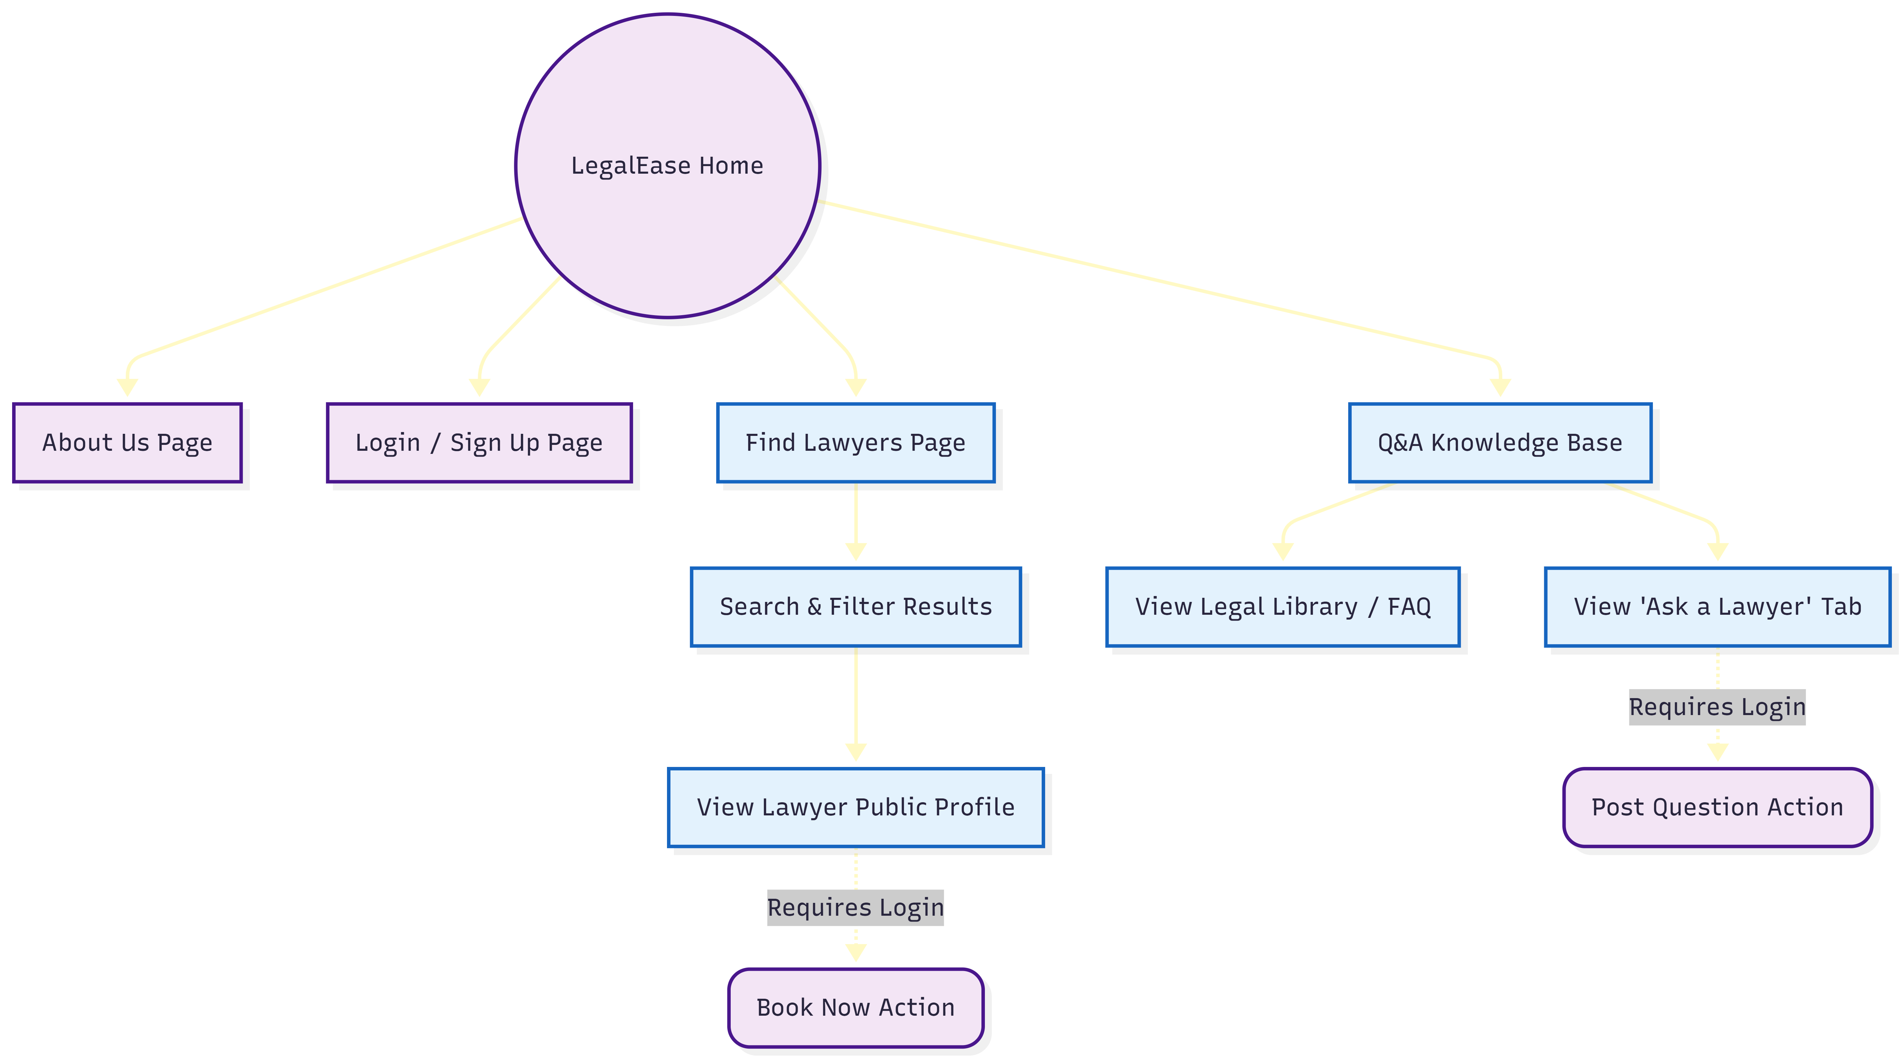
Flow Diagram

Slide 15
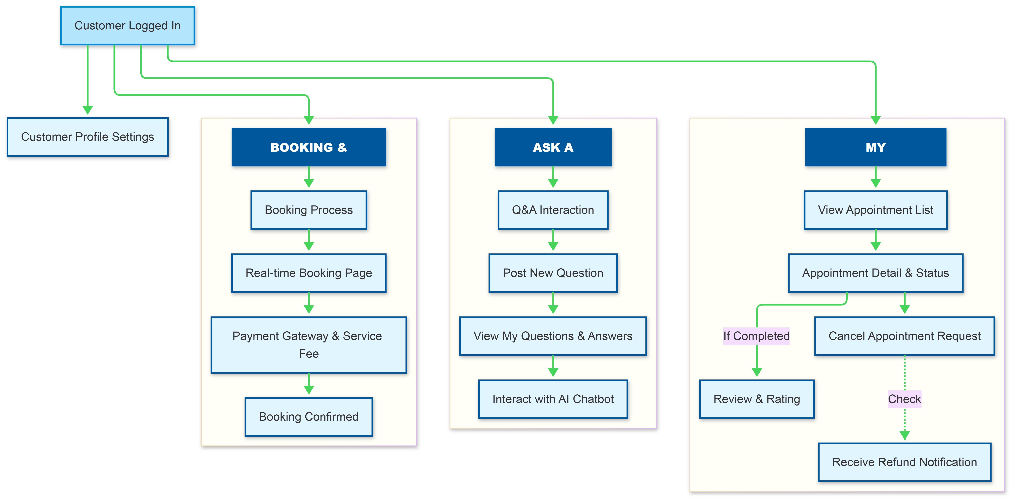
Flow Diagram

Slide 16
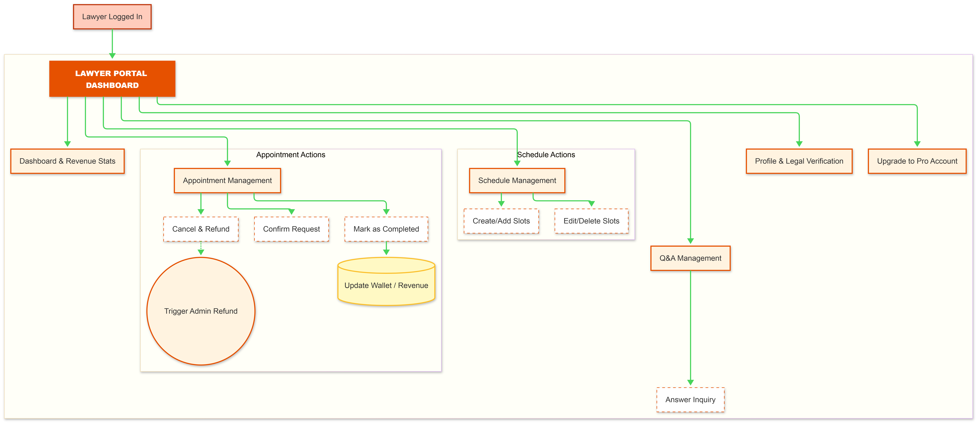
Flow Diagram

Slide 17
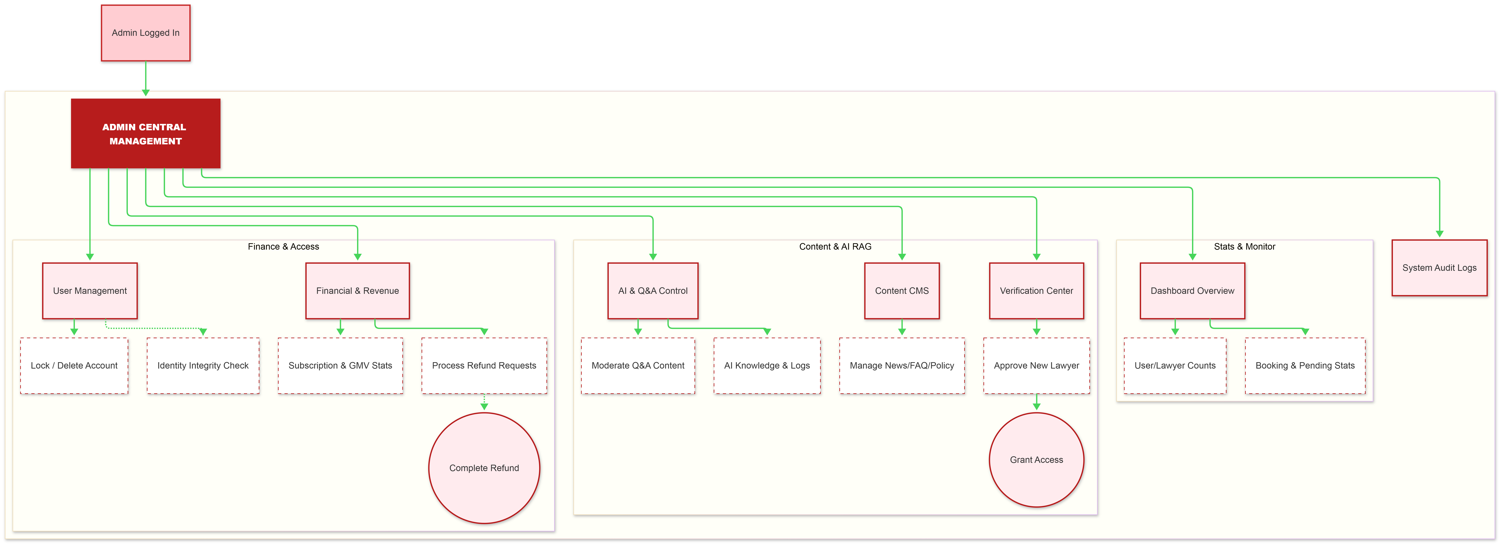
Flow Diagram

